Slide 1
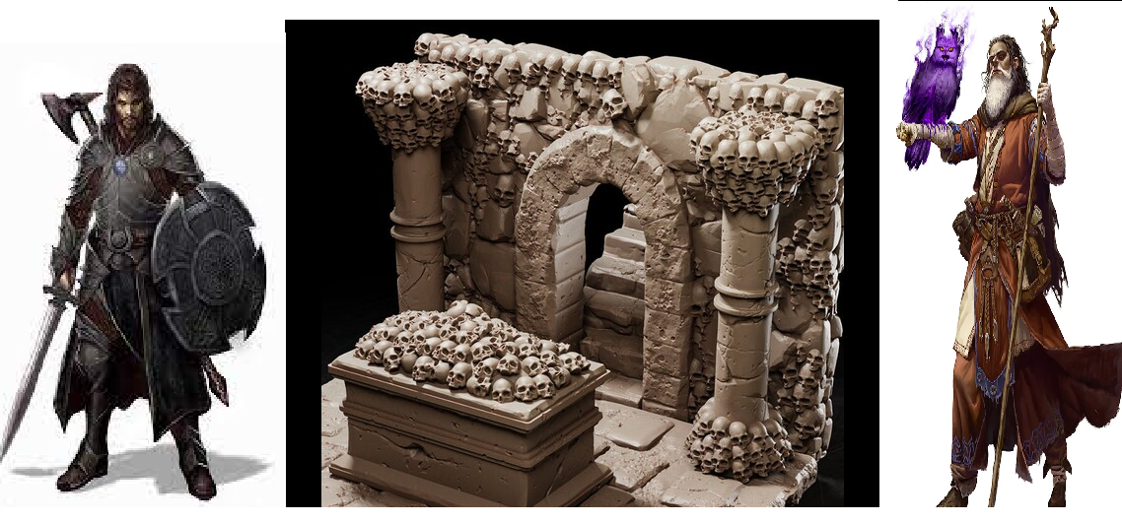
Underground Tactics
43
30
Pitch Date: April 7, 2024 Week 2
Release Date: July 28, 2024 43 Commits
Team Lead: Vince McKeown (+3) 4 Contributors
1
2
3
4
5
6
7
8
9
10
11
12
13
14
15
16
4/20/2024

Slide 2
Vince McKeown Commits
Code
Tiles now have properties for walkable, flyable, impassible, damage, and items
Player can levitate
Kobald enemy class

Slide 3
Dan Dela Rosa
Code
M to toggle Mute

Slide 4
Michael Tanner
Code
P pauses game
Simplified pause toggle function

Slide 5

Rodrigo Lopez
Added Spellbook

